Slide 1

Khulna University of Engineering & Technology
Department of Computer Science and Engineering
“Fire Phoenix” - An Advanced Fire Disaster Management System
Presented by:
Supervised by:
Md. Masudur Rahman Rabby
Roll: 1907113
Md. Repon Islam
Lecturer
Department of CSE,
KUET
George Tonmoy Roy
Roll: 1907114

Slide 2
OUTLINE
01
02
03
04
05
06
07
08
Introduction
Motivation
Objectives
Equipment Lists
System Implementation
Methodology
Future Study
Conclusions

Slide 3
01
INTRODUCTION
Let us introduce the basic idea of this project

Slide 4
INTRODUCTION
Introducing the “Fire Phoenix” – a comprehensive and innovative solution designed to enhance fire incident response and control.
This advanced system seamlessly integrates:
User-friendly mobile applications
An efficient admin panel for web-based operations
A cutting-edge fire-fighting robot to tackle emergencies effectively and swiftly.

Slide 5
CONCEPTS
Mobile Application
The system has an user friendly mobile application fo the users
Admin Panel
A dedicated web based admin panel to control data flow and the robot control
Fire fighting robot
A visual fire fighting robot to control the on site activities

Slide 6
02
MOTIVATION

Slide 7
MOTIVATION
The motivation behind this project lies in revolutionizing firefighting efficiency and safety. By creating an interconnected system between user reports, admin control, and firefighting robots, the aim is to significantly reduce response time during fire emergencies. Enhancing communication frameworks, exploring cutting-edge technologies like deep learning, drives the goal of swift, precise, and preemptive actions, ultimately aiming to save lives and minimize the impact of fire disasters.

Slide 8
03
OBJECTIVE
Let us discuss the key objectives of our project

Slide 9
OBJECTIVE
Android app designed for real-time fire incident reporting to an admin panel.
Data synchronization between the app and specialized firefighting robots equipped with obstacle avoidance and live streaming capabilities.
Remote control of robots via the admin panel for swift deployment upon receiving user-generated reports.
Enhances firefighting efficiency, prioritizing human safety by enabling rapid and precise actions in critical situations.

Slide 10
04
Equipment List
The required equipments for this project

Slide 11
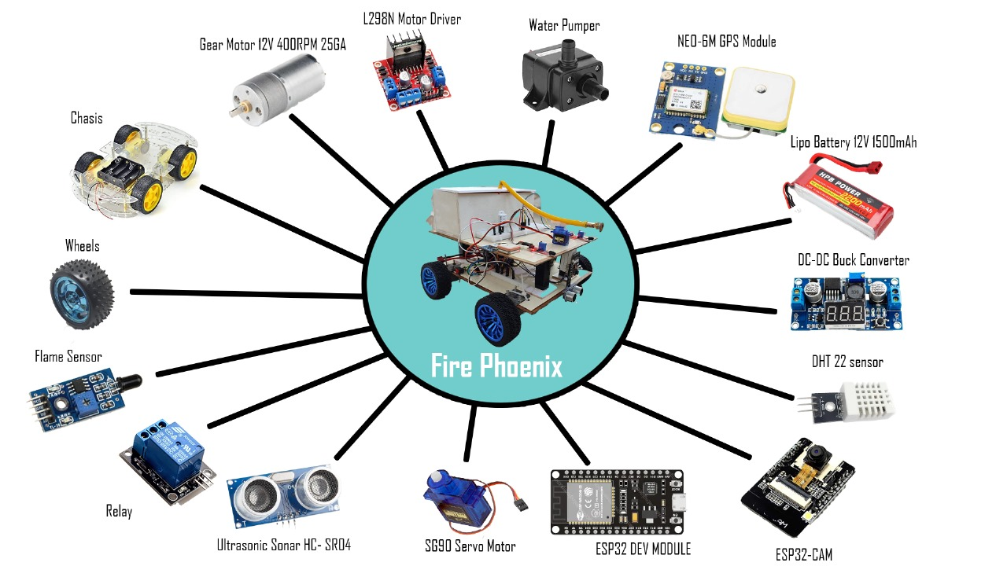

Slide 12
05
System Implementation
The system architecture of the system is described

Slide 13
Features of the System
Real Time incident reporting
Alerts and notification about the fire
Access location of the user
Autonomous robot’s fire detection
Remote robot control by admin panel
Search and rescue capabilities
Any kind of obstacle avoidence
Enhanced robot speed control
Real time video streaming on local server
Inteligent car control
Multi platform support

Slide 14
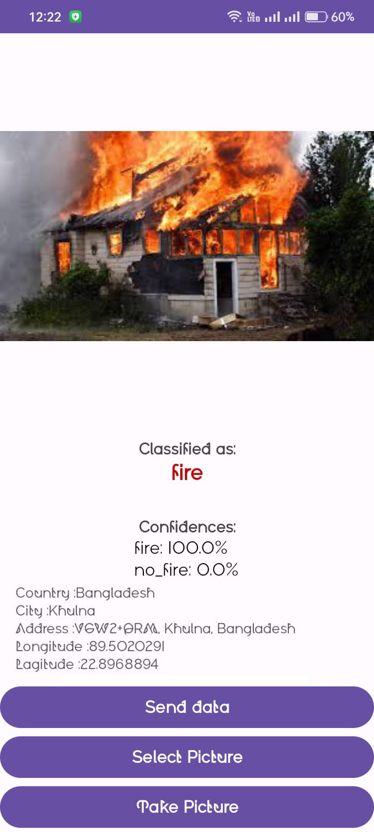
System Interfaces
User android application
For tracking user location
For fire detection data
Figure 1 : User App

Slide 15
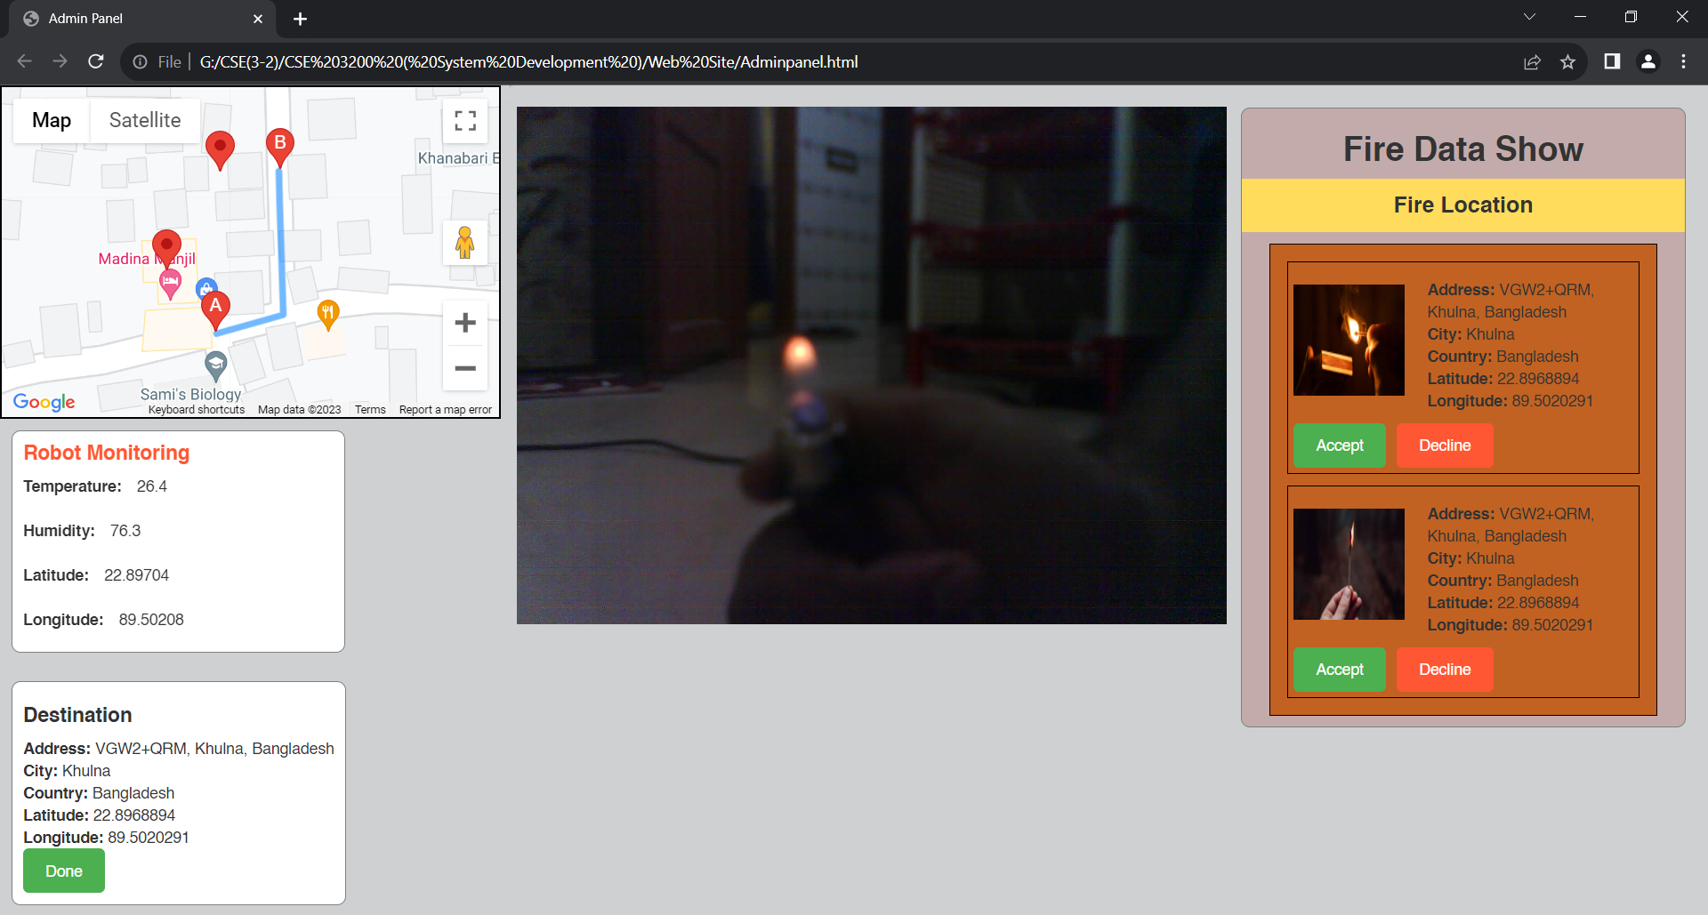
System Interfaces (Cont.)
Figure 2 : Admin Control Web Interface

Slide 16
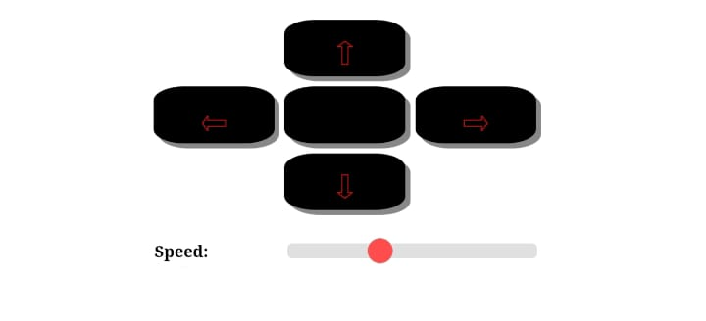
System Interfaces (Cont.)
Figure 3: Robot Control Web Interface

Slide 17
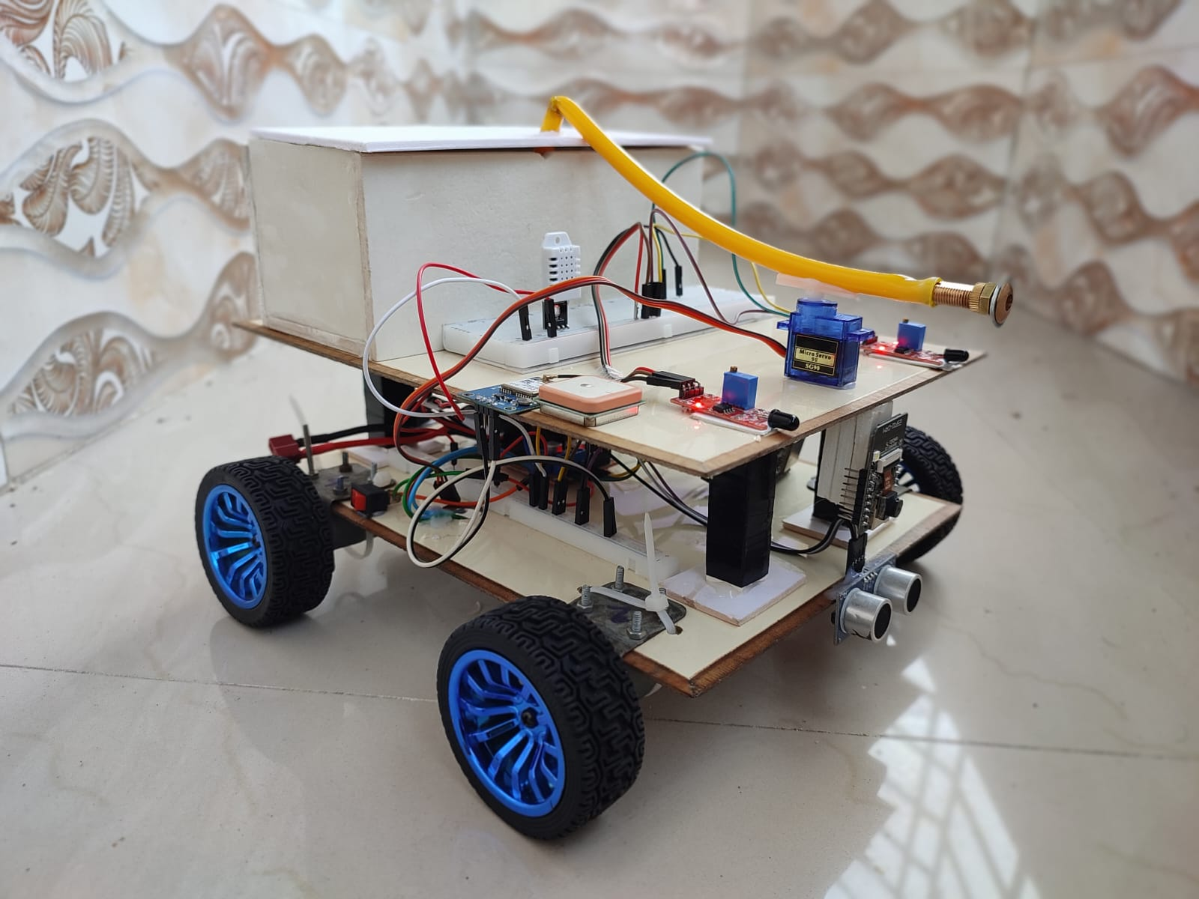
System Interfaces (Cont.)
Figure 4: Fire Phoenix Robot

Slide 18
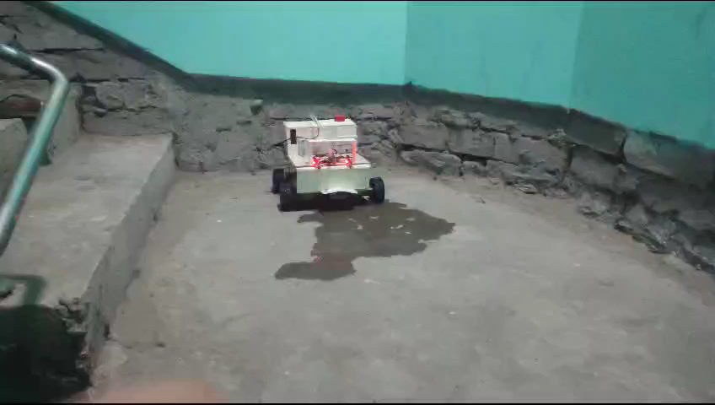
Demonstration

Slide 19
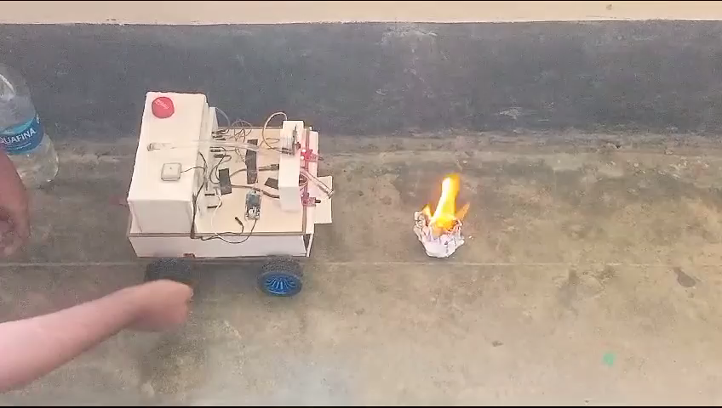
Demonstration(Cont.)

Slide 20
06
Methodology

Slide 21
Methodology
Our fire-fighting robot project is the integration of hardware and software together to build a system. The approach encompasses:
1. Mobile App Development:
Integration of a deep learning model for fire detection.
Image selection functionalities.
2. Web App Framework:
Establishing connections with Firebase, and a local server.
Load Google for real-time location tracking
Enabling comprehensive robot control, monitor Sensor data

Slide 22
Methodology(Cont.)
3. Robot Hardware Configuration:
Integration of essential components - cameras, sensors, motors, GPS, and microcontrollers.
Powering the system via a 12V DC supply.
4. Communication Channels:
Utilization of diverse communication channels - HTTP server for camera feeds, Firebase for sensor data, and a local web server for precise robot control.
This methodology ensures a cohesive and efficient system, empowering swift and effective firefighting responses.

Slide 23
07
FUTURE STUDY

Slide 24
FUTURE STUDY
The project aims to:
Enhance design through parallel computing and communication framework
Improve system responsiveness and scalability, refine algorithms for efficient communication
Explore machine learning integration for predictive analysis
Enabling preemptive measures against fire spread for effective disaster containment

Slide 25
08
CONCLUSION

Slide 26
CONCLUSION
The project revolutionizes fire disaster management systems by integrating advanced technology. Challenges include real-time communication between admin panel, user app, and firefighting robot, and balancing user-friendly interfaces with complex functionalities. Despite these obstacles, the project showcases the potential of technological solutions in emergency responses. The challenge lies in refining systems for evolving disaster scenarios.

Slide 27
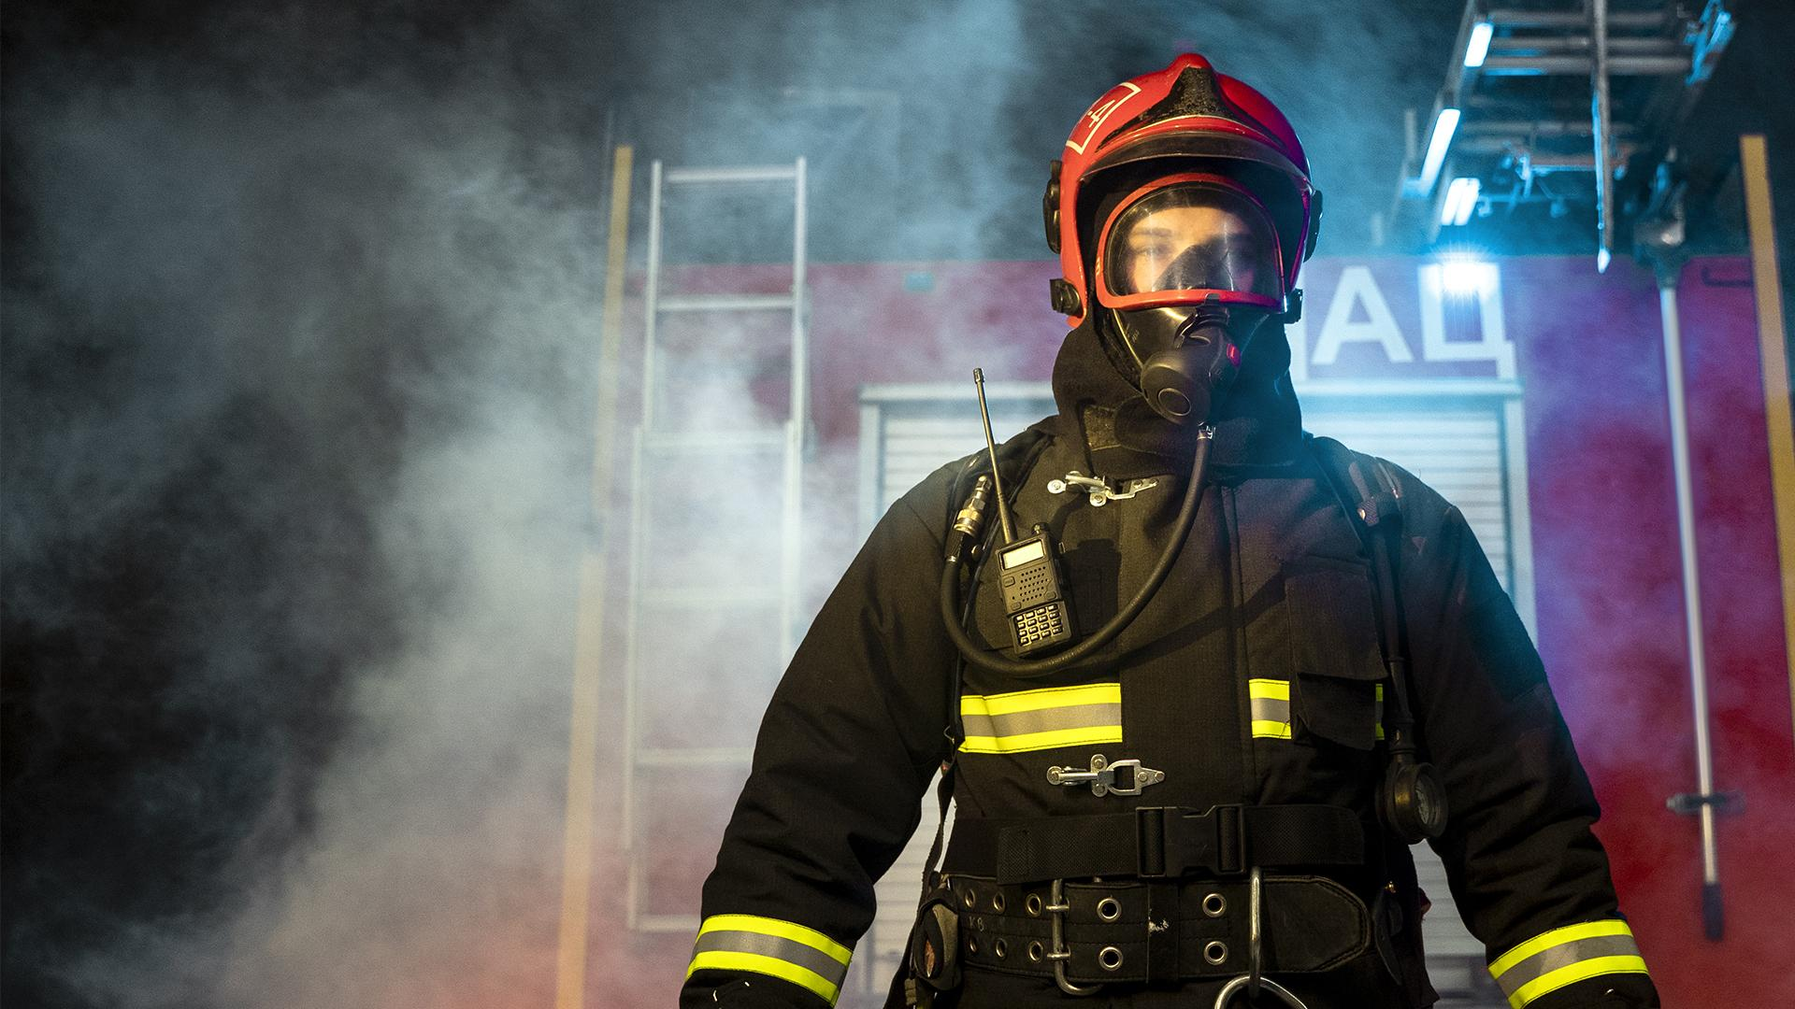
So
We are your rescuer

Slide 28
THANK YOU!

